Slide 1
Lesson 4
CAN Advance Topic
Notes:
1) Xin chao moi nguoi, cam on moi nguoi da tham gia vao khoa hoc FuSa
Buoi hom nay la ve phan session 1, overview ve FuSa
2) Truoc em cung gui tai lieu ve FuSa, anh chi em thay the nao.
Tai lieu co de hieu khong ah, cam giac FuSa co de khong ah.
3) Em xin phep buoi nay nhu chia se kien thuc, kinh Nghiem ve FuSa.
Cac anh chi em da co kinh Nghiem lau nam, nen neu co gi khiem khuyet xin cac anh chi em dai xa cho

Slide 2
Contents
CAN error
  Definition
  Error Frame Format
  CAN error states
CAN FD

Slide 3
CAN Errors
AGENDA
What is CAN Error
Reaction to CAN error
Types of CAN error
Understanding each type
What are Tx and Rx errors
Various scenarios and exceptions

Slide 4
What is CAN Error
Purpose of CAN: Communicate data from one node to other nodes in a network.
The data to be communicated is clubbed with frame related fields and communicated serially bit by bit
All the Rx nodes must receive the same information which the Tx application is intended. If some problem happens in this then we call as CAN error.
The problem may happen in Tx node, or CAN bus or Rx node. CAN protocol has capability to detect any such problem and raise an error flag.
So Depending on which node detects an error we have Tx errors and Rx errors

Slide 5
Reaction to CAN Error
When a node (Tx or Rx) detects a CAN error it starts sending the error flag on the bus immediately.
This Error flag is designed in a way that it destroys the data frame currently present on the bus.
Depending on this error flag other nodes also may put its own error flags on CAN bus.
All Error flags and delimiters together forms the error frame on the bus.
Depending on the node which raised the error flag, will increment its error counter value to keep track and manage CAN error states.

Slide 6
CAN Errors
There are 5 types of CAN errors
  Bit Error
  Acknowledgement Error
  CRC Error
  Stuff Error
  Form Error
Bit Error and Ack Error are called Transmitter errors
These decide the TEC counter increments
CRC, Stuff and form errors are called Receiver errors
These decide the REC counter increments

Slide 7
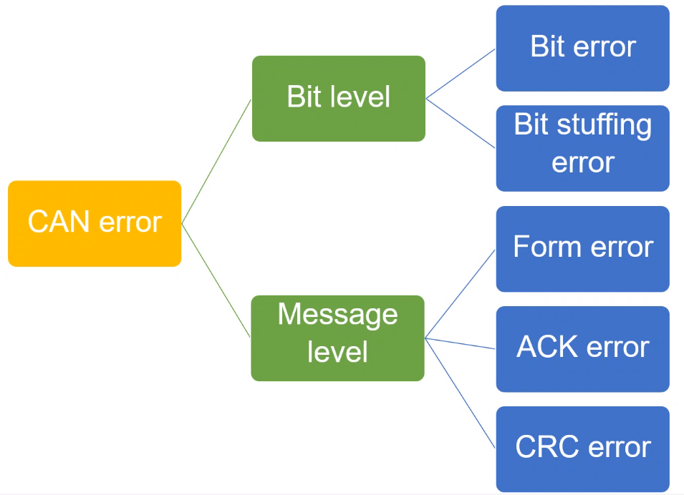
CAN Errors
Physical Layer related error
Data Link Layer related error

Slide 8
Bit Error
When the transmitter node monitors a different bit value than the value it transmitted in that bit, then its called as a bit error
Tx bit Sequence
Bit Error
Bit Monitoring
CAN Bus

Slide 9
Bit Error Exceptions
Use cases:
Tx puts Dominant (0) bit but finds a Recessive(1) bit on the bus
Tx puts Recessive (1) bit but finds a Dominant (0) bit on the bus
Exceptions:
1) During Arbitration, Tx puts a Recessive bit but finds a Dominant Bit then this means Lost in Arbitration and not Bit Error.
Note: During Arbitration if Tx node puts a Dominant bit but finds a Recessive bit on the bus, then this is a Bit Error only.
2) During Acknowledgement Slot, Tx node puts a Recessive bit but finds a Dominant Bit then this means Acknowledgement Received and not Bit Error.
3) After Ack slot, 11 consecutive Recessive bit is transmitted. In that fixed frame if a dominant bit is monitored then it will be a form error and ot Bit error.

Slide 10
Acknowledgement Error
When the transmitter node monitors a Recessive bit value in Ack Slot, then it means it did not get a Acknowledgement. This is Acknowledgement Error
CRC Error
Every CAN message contains a Cyclic Redundancy Checksum field of 15 bits. Here, the transmitter has calculated the CRC value and added it to the message. Every receiving node will also calculate the CRC on their own. If the receiver's CRC calculation does not match the transmitter's CRC, it will not give ACK, then the receiver detects this as a CRC Error and send Error frame.
Tx Node
Rx Node 1
Rx Node 2
CAN BUS

Slide 11
Case 1: No Error

Slide 12
Case 2: Acknowledgement Error

Slide 13
Case 3: CRC Error

Slide 14
Stuff Error
When a receiver receives at-least 6 consecutive bits of same polarity, then it means the bit stuffing rule is violated. This is Stuff Error.
In CAN protocol, if frame has consecutive 5 bits of same polarity then a complimentary bit is inserted after that called Stuff bit. This helps in better synchronization between Rx and Tx nodes.
Bit Stuffing is applied from SOF to Checksum field. So the scope of stuff error also is the same.
The moment the Stuff error is detected, the Rx node raises an error flag the very next bit, hence destroying the current data frame on the CAN Bus.

Slide 15
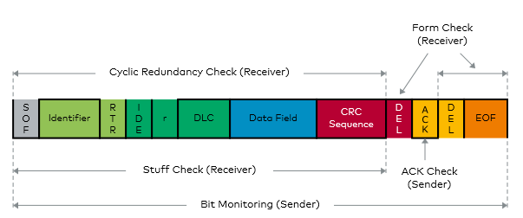
Form Error
When the Fixed form of the CAN data frame (CD + AD + EOF) is altered then Form error occurs.

Slide 16
Points to Remember
When a node Detects a error, it raises the error flag on the bus and destroys that data frame which is erroneous.
If the error is detected by a Tx node then they are called Tx Errors. Bit and Ack errors
If the error is detected by a Rx node they are Rx Errors. CRC, Form and Stuff errors
For Ack, Bit, Form and Stuff error, The error flag is raised as on the very next bit when the error was detected, For CRC error, error flag is raised after 1 bit gap(AD) when error is detected.
Tx error results in increments of TEC and Rx errors result in REC within a node.
Error frame format for all CAN error are same. Depending on at which part of data frame the error is raised, we can know which error is it.

Slide 17
Error Frame Format
AGENDA
Understanding Error Frame
What is Error flag and its types
What is basic error frame and complete error frame
How is error frame formed on the bus
Different Use cases to demonstrate formation of error frame on bus.

Slide 18
Error Frame
Error Frame is one of the 4 frame types given in the CAN protocol
Error Frame Signals to other nodes on the network that current Data frame is erroneous.
Any of the 5 CAN error upon detection by a node will result in destroying current data frame by overlap of Error frame
To understand Error frame format we have to understand below three aspects:
  Error Flag (Active and Passive)
  Basic Error Frame
  Complete Error Frame

Slide 19
Error Flag
When a node detects any CAN error, it knows that the current Data frame is not valid. So the node has to signal other nodes on the network.
The Node signals the error to remaining nodes by a flag. This is called Error flag.
Error Flag has to be noticed by all other Nodes and not be mistaken to be normal frame bits.
So the format of a Error flag is chose in a way that such format cannot exist anywhere in a normal data frame. → Violation of Bit stuffing rule.
So Error Flag is 6 consecutive bits of same polarity. Depending on Polarity of bits, there are two kinds of Error Flag
  Active Error Flag : 6 consecutive dominant bits (000000)
  Passive Error Flag : 6 consecutive recessive bits (111111)

Slide 20
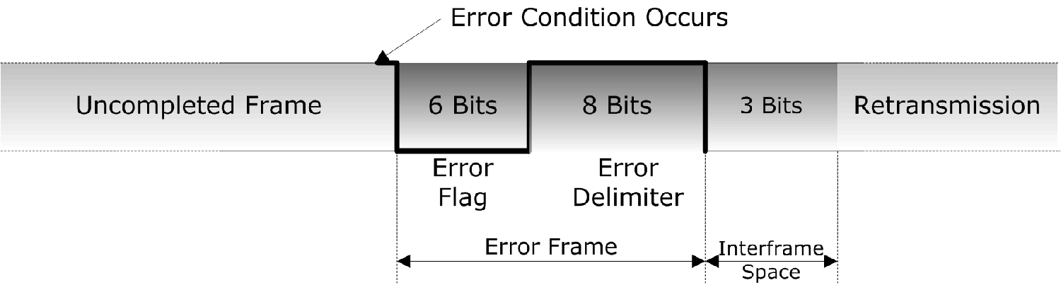
Basic Error Frame
A Basic Error frame consists of 3 parts:
6 bits of Error flag field
Active error flag : all dominant bits
Passive error flag : all recessive bits
8 recessive bits of Error delimiter field. (1 + 7)
3 recessive bits of Inter-frame space field.

Slide 21
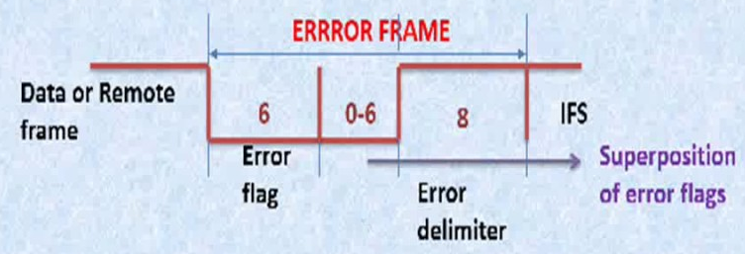
Complete Error Frame
Error Frame on CAN bus is combination of multiple basic Error frames by various nodes. Superposition of all Basic error frames forms complete error frame on bus.
After Error flag, 1st bit of Delimiter is sent by node. If it monitors a Dominant bit then it waits till a recessive bit is monitored on the bus and then send remaining 7 delimiter bits. Else if it monitors Recessive bit then sends remaining 7 Delimiter bits directly

Slide 22
Rx Detect – Active Flags
Bit Error
Some Rx Error
Stuff Error
Error Flag
Error Delimiter
Intermission

Slide 23
Rx Detect – Passive Flags

Slide 24
Tx Detect – Passive Flag

Slide 25
Points to Remember
Error frame signals the nodes that Data frame is invalid and hence not to process it.
Error frame always is sent in between a data frame destroying it on the bus.
Error frame consists of Error flag, delimiter and intermission.
Error flag is designed based o violation of Bit-stuffing Rule
Error flag can be active error flag or passive error flag.
Passive error flag from a node can destroy only the data frames the node transmits
Active error flag from a node can destroy the data frame the node transmits and receives.
Base error frames from various nodes together forms full error frame on the CAN bus
Once the error frame is finished the data frame shall be retransmitted again.

Slide 26
CAN Error States
AGENDA
Fault Confinement
Error Counters
CAN Error State machine
What is BusOff and how to come out of it.
TEC and REC counter rules

Slide 27
Fault Confinement
Guarantees proper network operation even in cases where malfunctioning nodes produce continuous error condition
CAN error detection can pinpoint to “perpetrator”
Distinction between temporary and permanent node failures
Identification and removal (self-retirement) of malfunctioning nodes from the bus

Slide 28
Error Counters
The CAN errors can be classified into Transmit and Receive errors.
Bit error and Acknowledgement error are transmit errors
Reason: These errors can be detected by only transmitting nodes.
CRC error, Form error & stuff error are receive errors
Reason: These errors can be detected by only receiving nodes.
There are 2 counters (count 0 to 255) for each node called error counters namely:
  Transmit Error Counter (TEC) : Increments depending on transmit error.
  Receive Error Counter (REC) : Increments depending on receive error.
The error counter increment pattern is not simple and depends on many factors as explained in later slides

Slide 29
CAN Error State Machine
Reset, Configuration
Error
Active
(Reset, Configuration) Or (Rx 11 consecutive Recessive bits 128 times)
(TEC < 128) AND
(REC < 128)
(TEC > 127) or
(REC > 127)
Error
Passive
BUS-OFF
TEC > 255

Slide 30
REC Counter Rules
REC increments by 1 when receiving node detects an error.
Exception: Detected error was a bit error during transmission of an active error flag or overload flag
REC increments by 8 when Rx node detects a dominant bit after sending an error flag.
REC increments by 8 when Rx node detects a bit error during sending an active error flag or overload flag.
REC increments by 8 if it detects 8 consecutive dominant bits after it sent its error flag.
REC decrements by 1 under following conditions
1. The frame was received properly without any error till ACK slot
2. Successful sending of ACK bit
3. REC is in between 1 and 127
If REC is greather than 127 then its value will be set to a value beterrn 119 and 127.

Slide 31
TEC Counter Rules
TEC will be incremented by 8 when Tx node sends an error flag.
Exception 1: The Tx node is error-passive and detects an ACK error and
doesn't detect a dominant bit while sending passive error flag (bit error).
TEC unchanged.
Exception 2: Tx node sends an error flag due to stuff error during bus
arbitration, where stuff-bit is sent recessive but monitored as dominant.
TEC unchanged.
TEC increments by 8 when Tx node detects a bit error during sending an active error flag or overload flag.
TEC increments by 8 if it detects 8 consecutive dominant bits after it sent its error flag.
TEC decrements by 1 after successful transmission of a frame unless its value is already 0.

Slide 32
CAN FD Introduction
AGENDA
What is CAN FD protocol
Improvements compared to CAN protocol

Slide 33
What is CAN-FD
CAN-FD is a communication protocol based on CAN.
Can-FD is an improvement over CAN.
Modern CAN controllers support both CAN and CAN-FD frames
Note: CAN-FD is not an substitute for CAN protocol. A single Automotive network can have both CAN frames and CAN-FD frames.
So CAN-FD protocol must be compatible with CAN protocol.

Slide 34
Advantages of CAN-FD over CAN
DATA: CAN-FD frame can carry upto 64 bytes of data where as CAN carries 8 bytes
SPEED: CAN-FD frame maximum speed upto 5Mbps whereas CAN frame upto 1Mbps.
Note: CAN-FD has dual speed (Bit rate). Data and CRC fields can be transmitted with higher speed. Remaining fields of the frame will be transmitted with lower speed same as CAN speed. This concept will be more clear in coming slides.

Slide 35
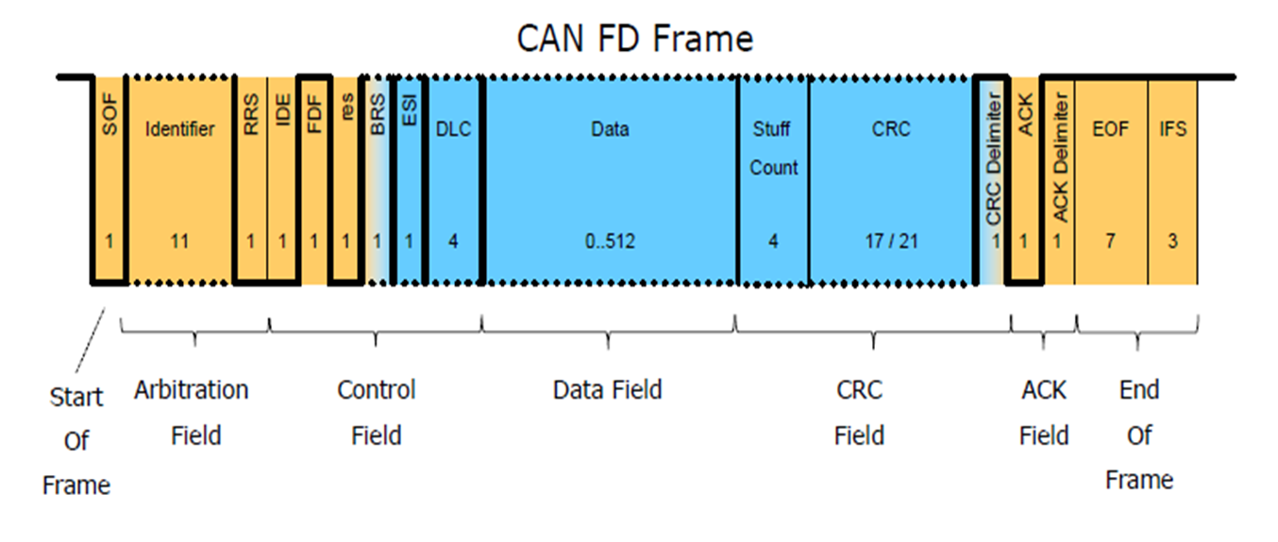
Data Frame Format

Slide 36
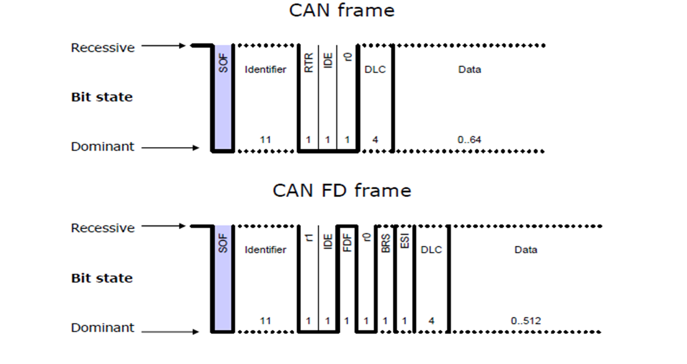
Start of Frame
CAN and CAN FD use the same SOF –a single “dominant” bit

Slide 37
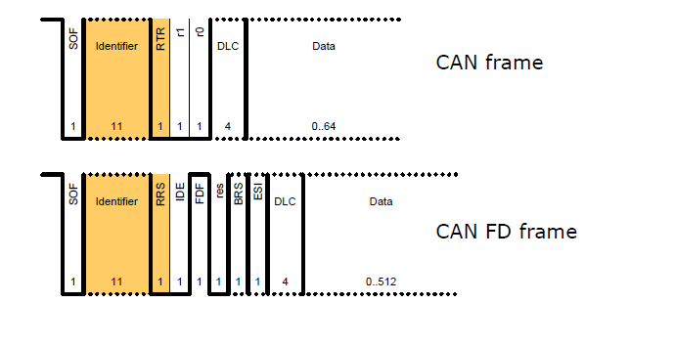
Arbitration Field
Little difference between CAN and CAN FD arbitration fields
Both share the same addressing for Standard and Extended formats
CAN FD removes the RTR bit and maintains an always dominant RRS bit

Slide 38

Control Field
CAN and CAN FD share the following bits:
- IDE , res and DLC bits.
CAN FD adds the following bits to the control field:
- FDF (FD Frame)
- BRS (Bit rate switch)
- ESI (Error state indicate)

Slide 39
Control Field
FDF (FD Frame) :
- Determines CAN FD (recessive)
- in classical CAN this bit is not present
BRS (Bit rate switch) :
- Clock rate switches when BRS is recessive
ESI –Error State Indicator (error active/pasive)

Slide 40
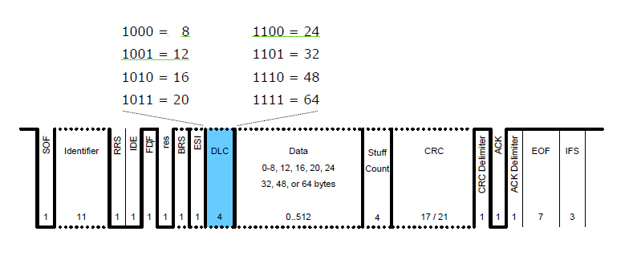
Control Field: DLC
4 bits are used for both formats (CAN and CAN-FD)
For DLC ≥ 8, CAN FD uses the following DLCs:

Slide 41
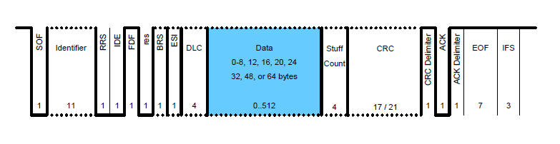
Data Field :
0-8 bytes in CAN
0-8, 12, 16, 20, 24, 32, 48, or 64 bytes in CAN FD

Slide 42
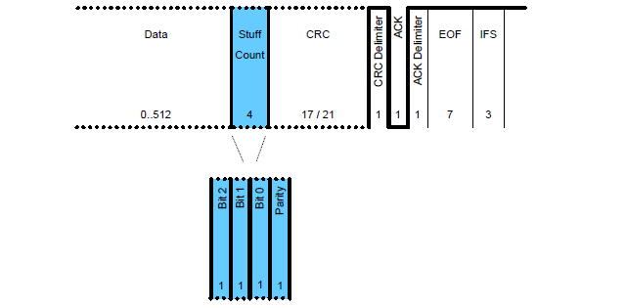
CRC Field: Stuff Count
How many Stuff bits are there in the bit stream are provided in the Frame after Data field.

Slide 43
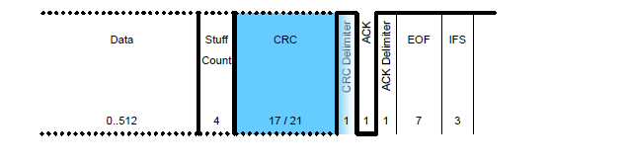
CRC Field: CRC Sequence
Size of CRC differs based on CAN/CAN FD and length of DLC
15 bits for CAN
17 bits for CAN FD where DLC ≤ 16 bytes
21 bits for CAN FD where DLC > 16 bytes

Slide 44
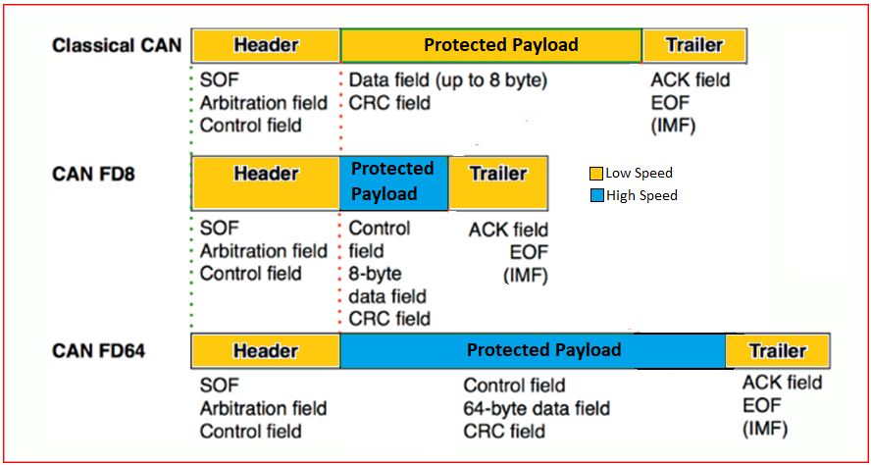
CAN-FD → Dual Speed and Higher Payload

Slide 45
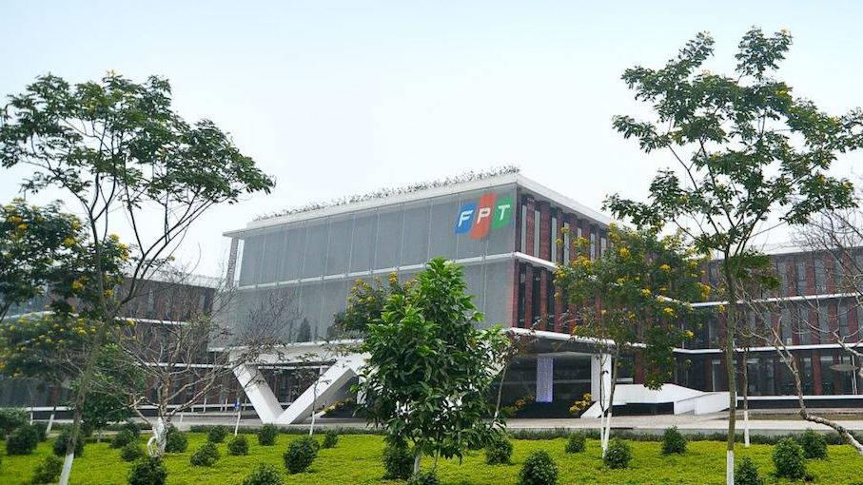


THANK YOU

